Slide 1
Project report - bearing
Group2
Bing-Hong Hong
Hsin-Ting Chou
Chih-Hao Chiang
Shao-Tse Chien

Slide 2
Outline
Background
Flow chart
Bearing dataset
Feature extraction
Feature selection
Cross-validation
Model training
conclusion

Slide 3
Background

Slide 4
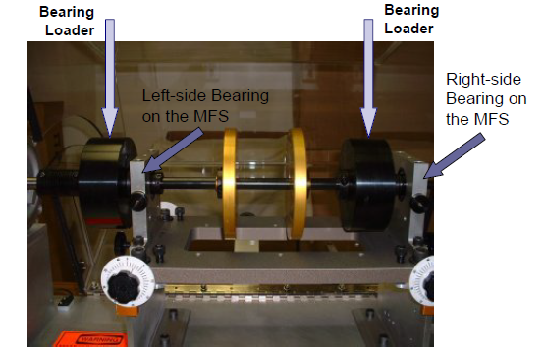
Introduction
Bearing is a machine element that can reduce sliding friction.
It can improves the efficiency, durability and performance.
Review of Techniques for Bearings & Gearbox Diagnostics.pdf

Slide 5
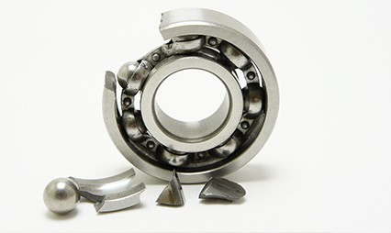
Purpose
The reason why we diagnosis bearings is to find out the defects in bearings which could cause machine vibration or damaged.
https://www.hansfordsensors.com/opening-the-envelope-on-bearing-vibration/damaged-bearing/

Slide 6
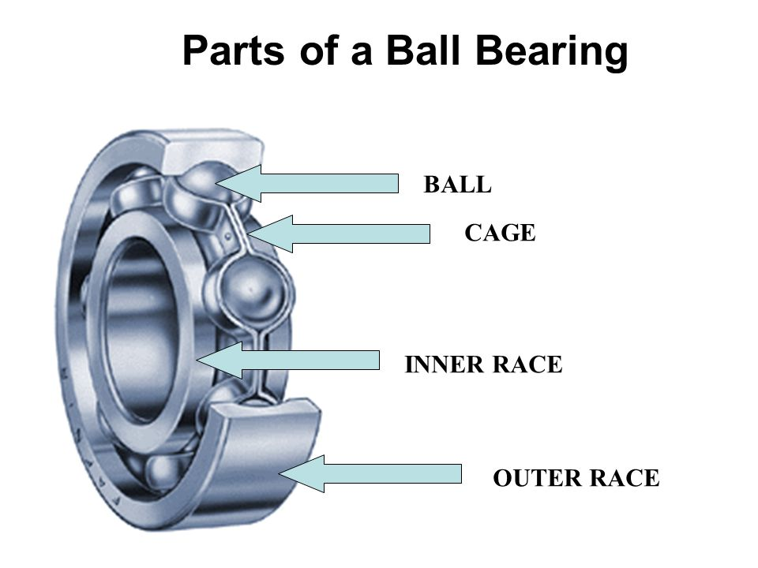
Cases
Healthy
Roller (Ball) damage
Inner race defect
Outer race defect
Inner + Roller
Outer + Roller
Inner + Outer
Inner + Outer + Roller
https://slideplayer.com/slide/5780979/

Slide 7

Situations
Ball Passing Frequency Outer Race (BPFO)
Ball Passing Frequency Inner Race (BPFI)
Fundamental Train Frequency (FTF)
Ball Spin Frequency (BSF)
D = pitch dia; d = ball dia; $φ$= contact angle;
n = no. of balls
Review of Techniques for Bearings & Gearbox Diagnostics.pdf

Slide 8
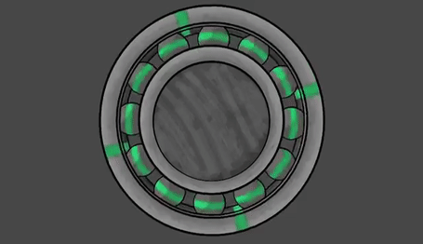
Situations(cont’d)
Bearing Defect
Frequency of Outer Ring Defect (FORD)
Frequency of Inner Ring Defect (FIRD)
Frequency of Ball Defect (FBD)
http://www1.udel.edu/present/Becky/bearing/
https://gfycat.com/lividsarcasticguineapig

Slide 9
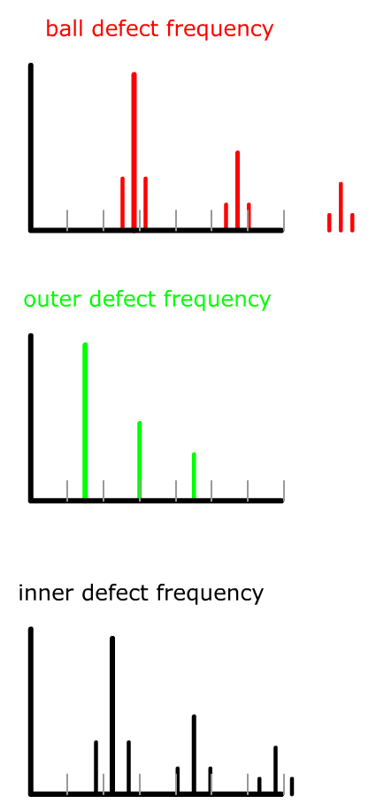
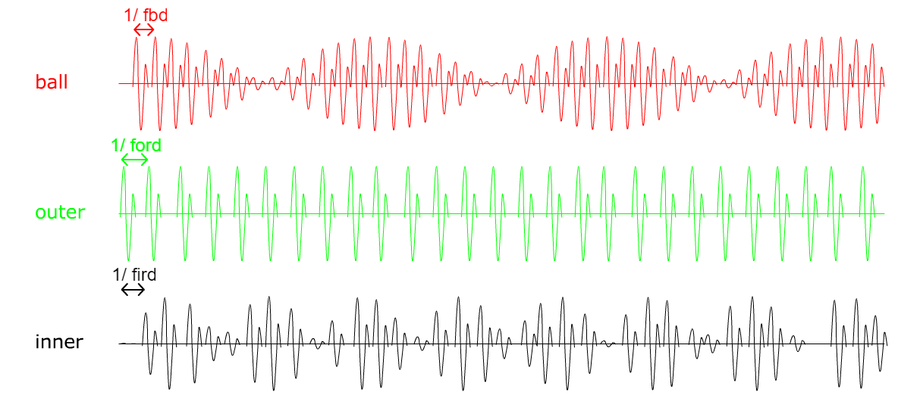
Situations(cont’d)

Slide 10
Solutions
Time Waveform Analysis
Frequency Spectral Analysis
High Frequency Detection (HFD)
Stress Wave Analysis or Spike Energy
Enveloping

Slide 11
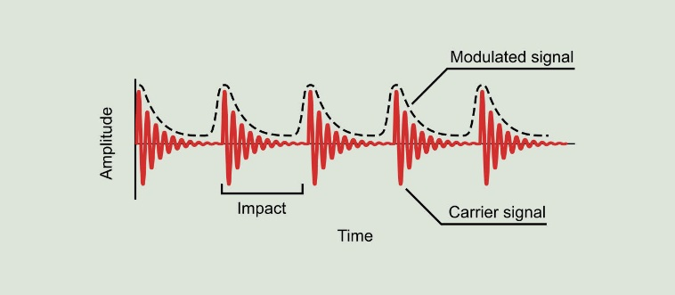
Enveloping
Enveloping is a technique that can extract the modulating signal from an amplitude modulated signal.
http://www.power-mi.com/content/demodulation-or-envelope-analysis

Slide 12
Feature of bearing fault
Rolling element bearing fault frequencies are generated when a bearing begins to fatigue.
Time domain statistical parameters, such as Root Mean Square Amplitude (RMS), are also calculated from vibration data and monitored for a significant increase in magnitude.
These fault or defect frequencies are calculated using bearing geometry and speed.

Slide 13
Feature of bearing fault(cont’d)
Manually observing the spectrum for increases throughout testing was not feasible due to the fact that these tests often ran unattended. For this reason, a technique was developed to trend the defect frequencies on-line. Using the defect frequencies BPFI, BPFO, BSF, FTF as indexes for the frequency domain data.

Slide 14
Assumptions Made in Bearing Fault Frequencies
1. All balls/rollers are equal in diameter
2. There in pure rolling contact between balls, inner race and outer race.
3. There is no slipping between the shaft and the bearing
4. Outer race is stationary and inner race rotates
Bearing faults create a series of impacts which are amplified by resonances: bearing, sensors, structure etc

Slide 15
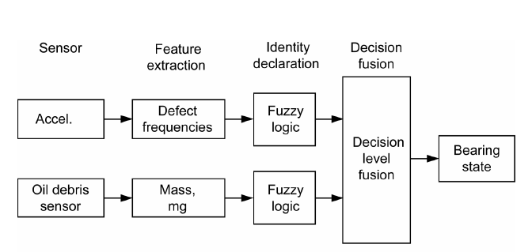
Decision Fusion Analysis
Reference: Dempsey, Paula J., Gary Kreider, and Thomas Fichter. "Tapered Roller Bearing Damage Detection
Using Decision Fusion Analysis." (2006).

Slide 16
Flow chart

Slide 17
Flow chart
SOM
Data
Preprocessing
Feature extraction
Feature selection
GMM+EM

Slide 18
Bearing dataset

Slide 19
Bearing dataset
training data is given with 2048 tests, as well as labels for all the 2048 tests. Labels are numbers from 1 to 8, and each class has 256 samples, corresponding with normal, roller, inner race, outer race, inner race & roller, inner race & outer race, outer & inner race & roller, and outer race & roller.

Slide 20
Feature extraction
Time domain: Mean、Variance、Skewness、Kurtosis、Entropy、Peak-to-peak、RMS
Frequency domain: BSF、BPFI、BPFO、23 Hz

Slide 21
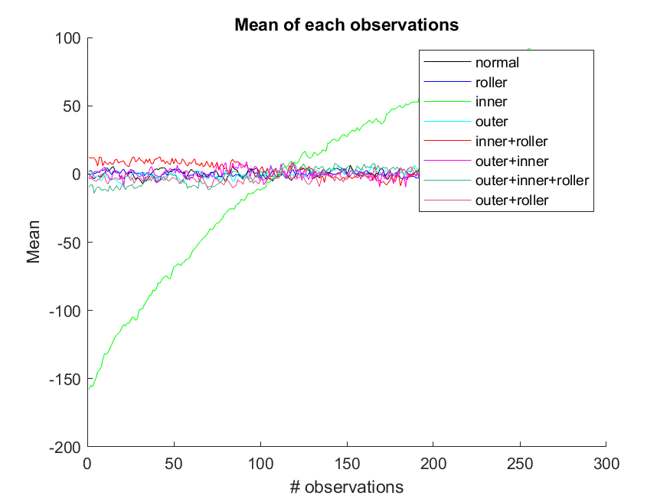
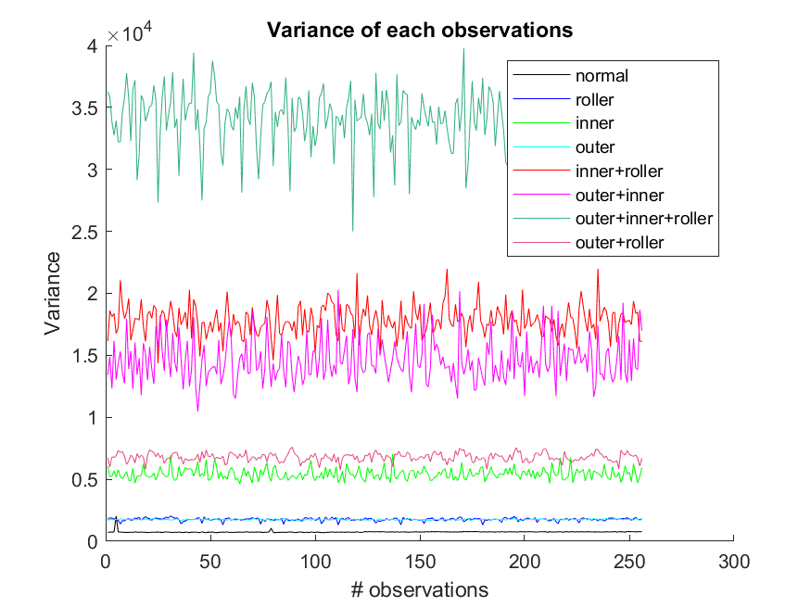
Feature visualization(cont’d)

Slide 22
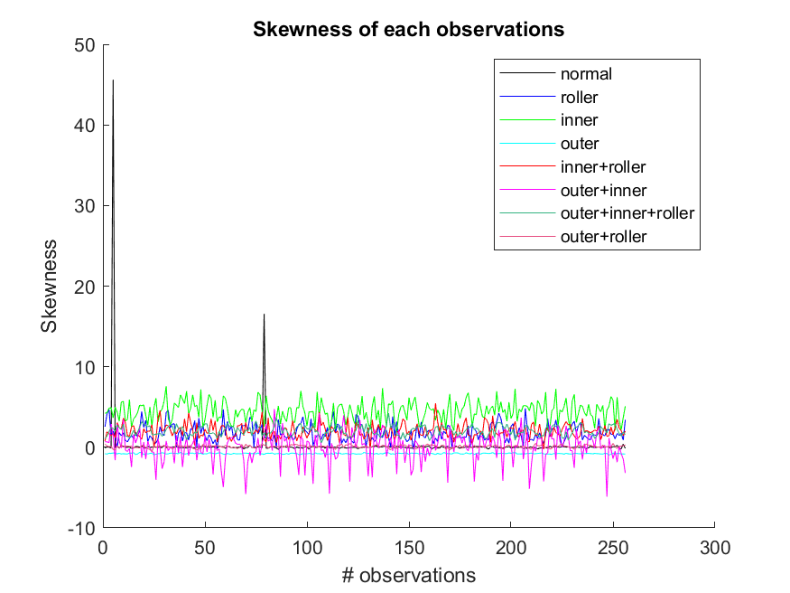
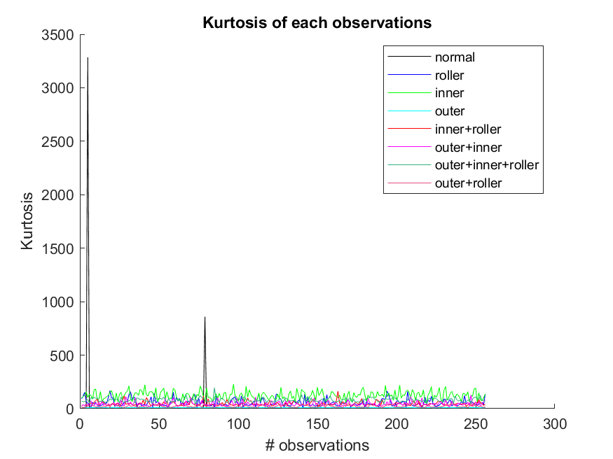
Feature visualization(cont’d)

Slide 23
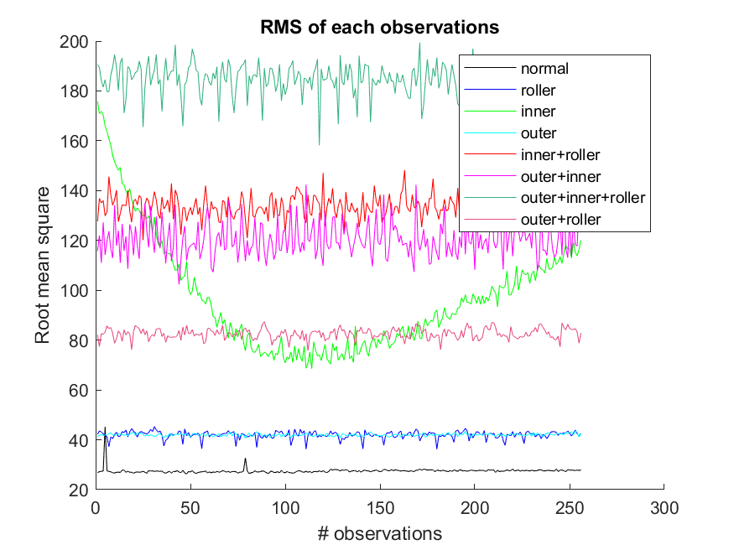
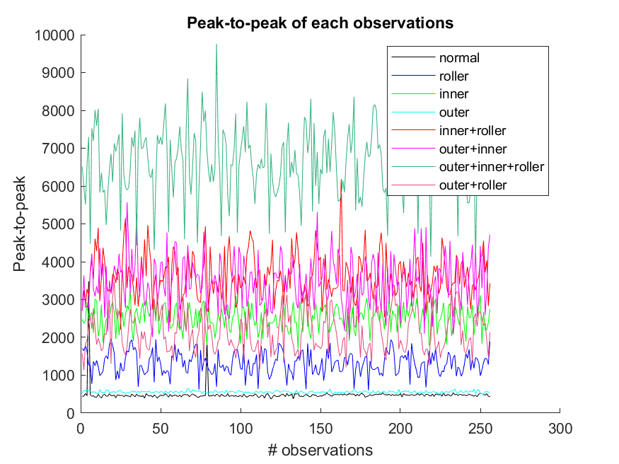
Feature visualization(cont’d)

Slide 24
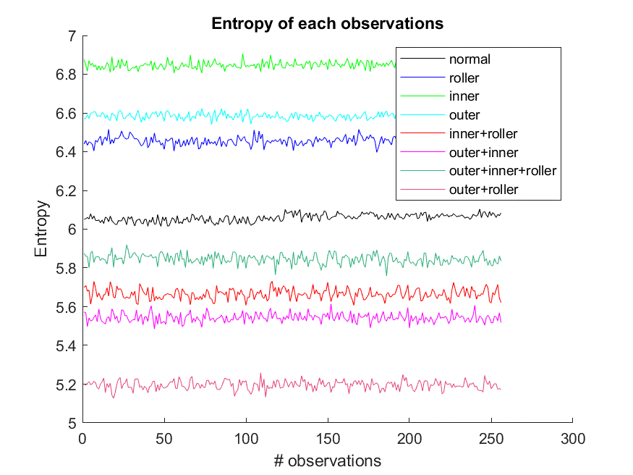
Feature visualization(cont’d)

Slide 25
Feature selection

Slide 26
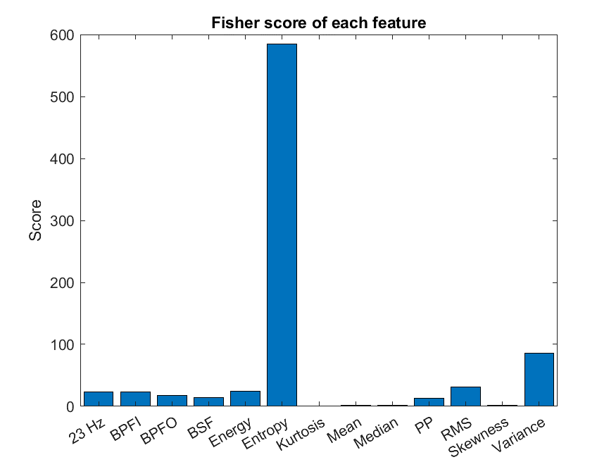
Fisher score

Slide 27
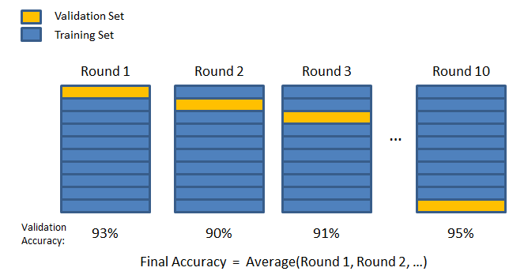
K-fold Cross validation(K=4)

Slide 28
Model training
SOM
GMM+EM

Slide 29
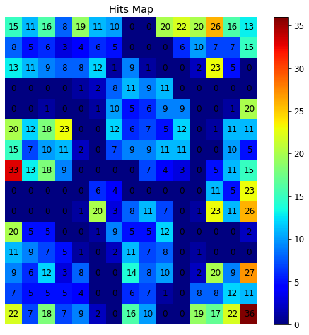
SOM

Slide 30
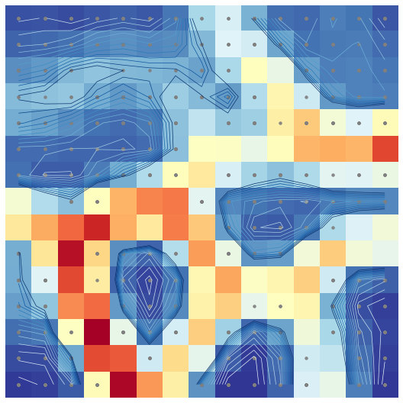
SOM U-Matrix

Slide 31
conclusion
Time domain feature is better than frequency domain.
According to fisher criterion, entropy is the best feature to diagnosis bearing fault.
In the future, the machine learning algorithm such as SOM and EM+GMM will be utilized to determine which condition of bearing is.

